Slide 1


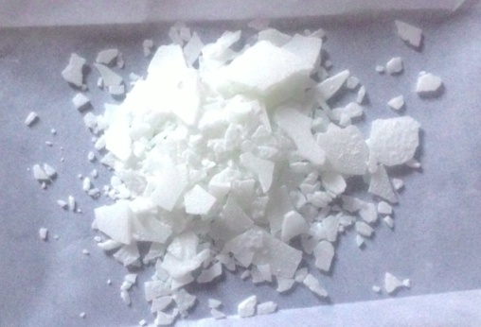
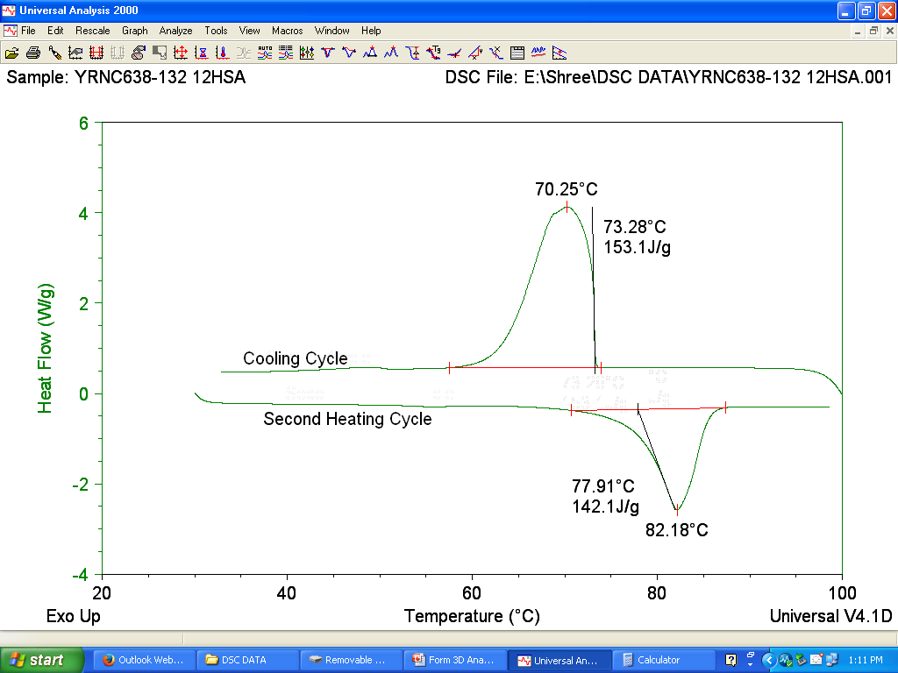
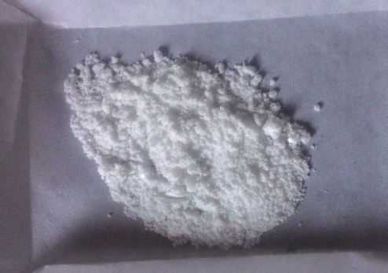
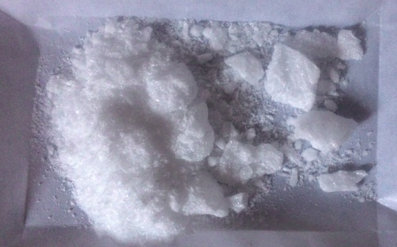
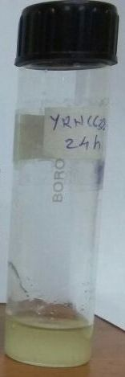
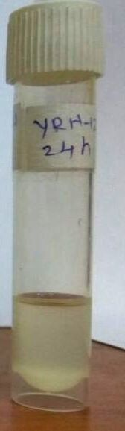
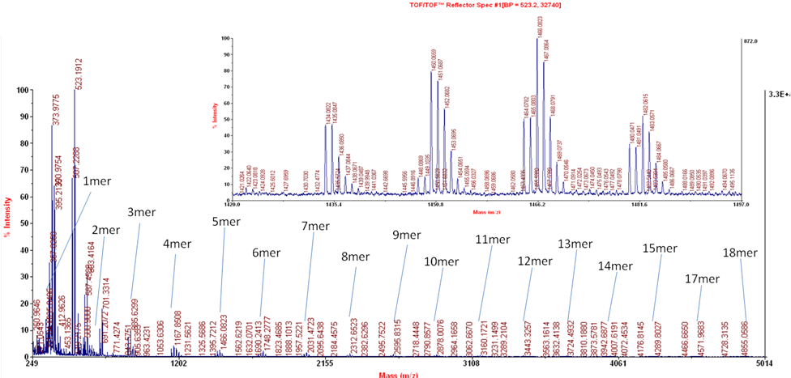
Synthesis of aliphatic polyesters from methyl 12-hydroxystearate, a bio derived AB monomer
Yogesh R. Nevare, Devyanee J. Nemade and Swaminathan Sivaram*
Polymer Science and Engineering Division, CSIR- National
Chemical Laboratory, Dr. Homi Bhabha Road, Pune 411008, India
email id: s.sivaram@iiserpune.ac.in, yr.nevare@ncl.res.in
Objectives
12-hydroxystearic acid (12-HSA) is a biorenewable AB monomer and is readily available from castor seed oil.
However, commercial 12-HSA contains several monofunctional impurities which can act as chain terminator. It is not surprising, therefore, there is only one report of polymers derived from 12-HSA (Poly(12-HSA)) with reasonably high molecular weights¹.
Long aliphatic segments in polyesters provide significant opportunity for enahancement of crystallinity². However, the hexyl side chain in a polymer derived from 12-HSA is likely to inhibit crystallization.
We have explored the use of purified methyl 12-hydroxy stearate (Me 12-HS) as an AB monomer for polymerization by transesterification-polycondensation (TE-PC) using suitable catalysts.
Synthesis of Me 12-HS and Poly(methyl 12-hydroxy stearate) (Poly(Me 12-HS))
Purification of 12-HSA
Commercial 12-HSA
b
c
f
c
b
Commercial 12-HSA
(75 % purity) m.p. 77ºC
a
d
e
Unsaturation
absent
e
b
a
Purified Me 12-HS
m. p. 55-58ºC (lit. 50-51ºC)
Purified 12-HSA
f
d
c
12-HSA dissoved in pet ether, decanted (4 time)
Recrystallization from ethyl acetate (4 times)
m.p. 82ºC
¹H NMR (500MHz) spectrum of purified 12-HSA in CDCl₃
DSC of the 12-HSA
Absence of unsaturation and the ratio of e/f peak is 2:1, indicates this is an AB monomer.
The highest reported m.p. in the literature with purity of > 99% observed m.p 82ºC¹.
¹H-NMR of Me 12-HS
¹H-NMR of Poly(Me 12-HS)
DP vs time
MALDI-TOF of Poly(Me 12-HS)
b
c
c
b
Cyclic Na+ adduct
Cyclic K+ adduct
Linear Na+ Adduct
Linear K+ adduct
a
f
d
e
g
Unsaturation
absent
g
e
c
b
f
d
a
¹H NMR (500MHz) spectrum of vacuum distilled Me12-HS in CDCl₃.
¹H-NMR (200 MHz) spectrum of sample 8 (180ºC) (after 24 h) in CDCl₃.
Cyclics begin to form even at early stages of transesterification. The concurrent formation of cyclics could restrict the efficient polymerization of this monomer.
Absence of unsaturation and the ratio of g/f/e peak is 3:1:2, indicates this is an AB monomer.
The degree of polymerization was calculated by integrating proton g with proton h.
The rate of polymerization, as evidenced by the change of DP with time, indicates that the rate is faster with a titanium based catalyst at both temperatures.
Synthesis cyclic dimer of 12-HSA and Poly(12-HSA)
¹H-NMR of Cyclic dimer of 12-HSA
¹H-NMR of Poly(12-HSA)
c
b
a
f
c
b
d
e
b
e
d
b
c
f
a
b
c
e
d
c
a
b
f
g
f
e
c, d
a
¹H NMR (500MHz) spectrum of purified cyclic dimer of 12-HSA in CDCl₃.
¹H NMR (200MHz) spectrum of p(12-HSA) in CDCl₃.
The method of hydrolysing a cyclic dimer of 12-HSA may offer another method to generate monomer grade 12-HSA; additionally a ROP of the cyclic dimer using an appropriate catalyst may offer a method to directly make polymers of 12-HSA.
Disappearance of peak at 3.59 ppm due to the linear chain indicate that the formation of cyclic dimer
ROP of cyclic dimer of 12-HSA was confirmed by the opening of ring by the appearance of peak at 3.59 ppm
Future Work
References
To understand the scope and limitation of transesterifcation- polymerisation reaction of Me 12-HS using a monomer of high purity.
To prepare high purity 12-HSA monomer, either by crystallisation or hydrolysis of a cyclic dimer and examine its polyesterification reaction in melt.
To explore the feasibility of ROP of a cyclic dimer of 12-HSA.
To understand the importance of cyclic oligomer formation in such polymerisation.
Bawn, C. E. H.; Huglin, M. B. Polymer 1962, 3, 257.
Stempfle, F.; Ortmann, P.; Mecking, S. Chem. Rev. 2016, 116, 4597.
Granata, A.; Sauriol, F.; Perlin, AS. Can. J Chem. 1994, 72, 1684.
Acknowledgement
YRN acknowledges DST for INSPIRE fellowship and CSIR-NCL for facilities.

